Slide 1
Air Pollution Application
Soo Yeon Cho
Diba Jafarnejad
Irfan Mustafa

Slide 2

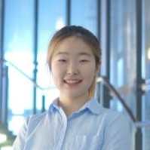
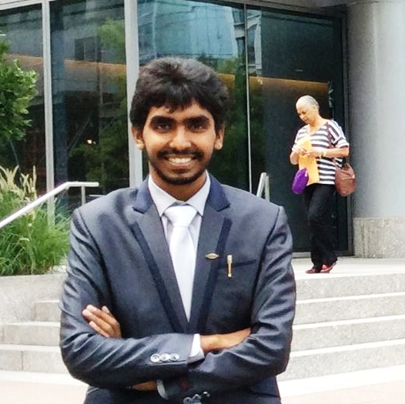
Diba Jafarnejad
Soo Yeon Cho
Irfan Mustafa
Software Consultant
Bell Business Unit
CGI
Developer
Bell Business Unit
CGI
Software Conslutant
Bell Business Unit
CGI
Notes:
My team has been hired to help individuals like John figure out the AQI of their city!

Slide 3

Meet John!
Notes:
- Meet John, he is a CGI employee that works at the Montreal and Toronto office
- he often travels back and forth and wants to know the air quality of the two cities every time he visits
- why does he want to know the air quality?

Slide 4
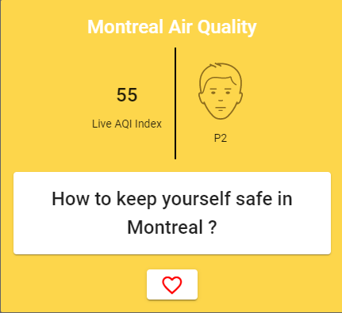
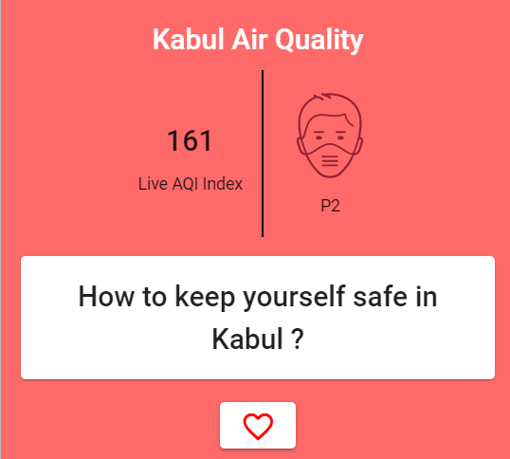
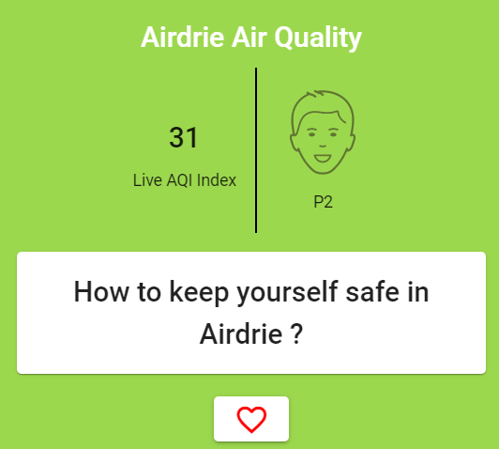
Air Quality Index (AQI)
0-50
50-100
> 100
Good
Moderate
Unhealthy
Notes:
- Depending on the AQI – or air quality index, it can be hazardous to people like John, with lung disease
- for him, 101-150 AQI can be hazardous for him

Slide 5
Objectives
Responsive interface
Information of air pollution
Personalised cities list
Secured authentication
Notes:
Quick user response.
Simple and interactive UI.
AQI of any specific city.
Preventive measures.
Find AQI of specific city using dropdowns
Display results of the last recent 3 searches
Registration/login for an account to store:
User profile picture
Favorited cities
We wanted to come up with an application that has a responsive, user friendly user interface to show the air quality index of specific cities. We also wanted to allow the user to have a profile, a list of favorite cities and secured authentication

Slide 6
Features
Find AQI of specific city using dropdowns.
Geolocation of the user.
Display results of the last recent 3 searches
Registration/login for an account to store:
User profile picture
Favorited cities

Slide 7

















Tools and Technologies
Notes:
Hibernate 2 – H2
Maven

Slide 8
Demo
Notes:
Register:
Username
should be a valid email
Should not already exist in the database
The form cannot be submitted with an empty username
Password:
Should be length 8
Should contain at least a digit, special character, lowercase and uppercase
Form cannot be submitted with empty password
Login:
Username
should be a valid email existed in the database
The form cannot be submitted with an empty username
The user should be existed in the database to be succusfully logged in

Slide 9
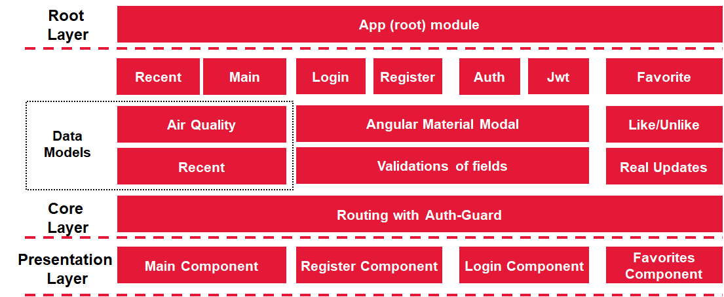
Front-end Architecture
Notes:
Real updates:
Main Page
Login:
Implemented using Angular Material Modal
Validations applied for username and password
Register
Implemented using Angular Material Modal
Validations applied for username and password
Sweet alert pops up upon successful registration
Account
Guard

Slide 10

Backend Architecture
API
Gateway
Eureka
Discovery
Microservices
Storage
Runtime
User
SQL
Favorite
Web-UI
MongoDB
Docker-Containers
Air Quality
Circuit
Breaker
AQI-Air
US-API
External APIs
Orchestration
Config-Server
Notes:
API Gateway - Implements a web security configuration (CSRF disabled, CORS enabled, sensitive headers removed)
Service discovery
Registers the services with specific IP addresses using eureka server
Database containing the network locations of service instance
Config server - Centralized configuration for all the microservices using central repository
Overall development:
Docker
CI/CD pipeline (in progress)
Unit Testing
Exception Handling

Slide 11
Front/Back-End Integration
Front-end
Back-end
Register
User
Login
Account
Favorite
Main Page
Favorites
Air Quality

Slide 12
Front/Back-end Integration
Front-end
Back-end
Register
User
Notes:
Maintain User information (email (id) and password and image)
Handles user registration and login
Generates authentication jwt token upon successful login
Uses sql database to store the user information
Authentication

Slide 13
Front/Back-end Integration
Front-end
Back-end
user2@mail.com
Abc123!@#
Register
User

Slide 14
Front/Back-end Integration
Front-end
Back-end
user2@mail.com
Abc123!@#
Register
User
user2@mail.com
asb3SD67ncvn
User email | (encrypted) Password | Image (byte [])
user1@mail.com | Fweh23&sdfsa | 0X01 0XAE..
H2
Notes:
encrypt

Slide 15
Front/Back-end Integration
Front-end
Back-end
user2@mail.com
Abc123!@#
Register
User
User email | (encrypted) Password | Image (byte [])
user1@mail.com | Fweh23&sdfsa | 0X01 0XAE..
user2@mail.com | asb3SD67ncvn
H2

Slide 16
Front/Back-end Integration
Front-end
Back-end
user2@mail.com
Abc123!@#
Register
User
user2@mail.com
Favorite
Notes:
Maintains user’s city preferences and stores data for query parameters retrieved the air quality information
Uses MongoDB to store favorite city (country name, state and city, user id)

Slide 17
Front/Back-end Integration
Front-end
Back-end
Register
User
user2@mail.com
Favorite
user1@mail.com
favorite: [
{country:
state:
city:}
]
user2@mail.com
favorite: []
Mongo DB

Slide 18
Front/Back-end Integration
Front-end
Back-end
User
Login

Slide 19
Front/Back-end Integration
Front-end
Back-end
user2@mail.com
Abc123!@#
User
Login

Slide 20
Front/Back-end Integration
Front-end
Back-end
user2@mail.com
Abc123!@#
User
Login
user2@mail.com
asb3SD67ncvn
User email | Password | Image (byte [])
user1@mail.com | Fweh23&sdfsa | 0X01 0XAE..
user2@mail.com | asb3SD67ncvn
H2
Notes:
Authentication!

Slide 21
Front/Back-end Integration
Front-end
Back-end
User
user2@mail.com
JWT
Login

Slide 22
Front/Back-end Integration
Front-end
Back-end
User
user2@mail.com
JWT
Login
Local Storage

Slide 23
Front/Back-end Integration
Front-end
Back-end
User
user2@mail.com
JWT
Login
JWT
Local Storage

Slide 24
Front/Back-end Integration
Front-end
Back-end
User
user2@mail.com
JWT
Login
JWT
jwttoken | JWT
Local Storage

Slide 25
Front/Back-end Integration
Front-end
Back-end
User
Account

Slide 26
Front/Back-end Integration
Front-end
Back-end
JWT
profile picture
User
Account

Slide 27
Front/Back-end Integration
Front-end
Back-end
JWT
profile picture
User
Account
User email | Password | Image (byte [])
user1@mail.com | Fweh23&sdfsa | 0X01 0XAE..
user2@mail.com | asb3SD67ncvn
H2

Slide 28
Front/Back-end Integration
Front-end
Back-end
JWT
profile picture
User
user2@mail.com
profile picture
Account
User email | Password | Image (byte [])
user1@mail.com | Fweh23&sdfsa | 0x01 0xAE..
user2@mail.com | asb3SD67ncvn | 0xF2 0x11…
H2

Slide 29
Front/Back-end Integration
Front-end
Back-end
Main Page
Air Quality
Notes:
Receives request and retrieves data from the third party API
Makes a request to favorite microservice for retrieving data of favorite cities
Model mapping using google json library
Caching multiple data values for recurring requests
Implements circuit breaker pattern to build fault tolerant resilient system

Slide 30
Front/Back-end Integration
Front-end
Back-end
Request Data
Main Page
Air Quality

Slide 31
Front/Back-end Integration
3rd-Party APIs
Air
Quality
Object Mapper
API
Gateway
Eureka
Discovery
AirQuality{
Aqi:"22",O3:"2.504"
SO2:"5.90",NO2:"5.12"
CO:"1.57"
PMI:"5.23"}
Json
Weather-API
If (Country==USA)
AQI-API
Storing Cache
Main Page
Air Quality
Rest
Template
Load Balancer
Local API
Storing Cache
Jwt
Favorite
FavoriteItem{
Country:"Canada",
State:"Quebec"
City:"Montreal".}
Useremail{
FavoriteItem
}
FavoriteItem

Slide 32
Front/Back-end Integration
Front-end
Back-end
3rd Party API
Returns Data
Main Page
Air Quality

Slide 33
Front/Back-end Integration
Front-end
Back-end
3rd Party API
Returns Data
Main Page
Air Quality
Returns Data

Slide 34
Front/Back-end Integration
Front-end
Back-end
Favorite
Main Page
*When user is logged in

Slide 35
Front/Back-end Integration
Front-end
Back-end
JWT
Add Canada, Ontario, Toronto
Favorite
Main Page
*When user is logged in

Slide 36
Front/Back-end Integration
Front-end
user1@mail.com
favorite: [
{country:
state:
city:}
]
Back-end
user2@mail.com
favorite: []
JWT
Add Canada, Ontario, Toronto
Favorite
Main Page
*When user is logged in

Slide 37
Front/Back-end Integration
Front-end
user1@mail.com
favorite: [
{country:
state:
city:}
]
Back-end
user2@mail.com
favorite: []
user2@mail.com
Canada, Ontario, Toronto
JWT
Add Canada, Ontario, Toronto
Favorite
Main Page
*When user is logged in

Slide 38
Front/Back-end Integration
Front-end
user1@mail.com
favorite: [
{country:
state:
city:}
]
Back-end
user2@mail.com
favorite: [{
country: Canada,
state: Ontario,
city: Toronto
}]
user2@mail.com
Canada, Ontario, Toronto
JWT
Add Canada, Ontario, Toronto
Favorite
Main Page
*When user is logged in

Slide 39
Front/Back-end Integration
Front-end
Back-end
Main Page
*When user is logged in
Air Quality

Slide 40
Front/Back-end Integration
Front-end
Back-end
Request favorited cities
JWT
Main Page
*When user is logged in
Air Quality

Slide 41
Front/Back-end Integration
Front-end
Back-end
Favorite
Request favorited cities
JWT
Main Page
Request Favorited cities
JWT
*When user is logged in
Air Quality

Slide 42
Front/Back-end Integration
Front-end
user1@mail.com
favorite: [
{country:
state:
city:}
]
Back-end
user2@mail.com
favorite: [{
country: Canada,
state: Ontario,
city: Toronto
}]
user2@mail.com
Favorite
Request favorited cities
JWT
Main Page
Request Favorited cities
JWT
*When user is logged in
Air Quality

Slide 43
Front/Back-end Integration
Front-end
user1@mail.com
favorite: [
{country:
state:
city:}
]
Back-end
user2@mail.com
favorite: [{
country: Canada,
state: Ontario,
city: Toronto
}]
[{Canada, Ontario, Toronto}]
Favorite
Main Page
*When user is logged in
Air Quality

Slide 44
Front/Back-end Integration
Front-end
user1@mail.com
favorite: [
{country:
state:
city:}
]
Back-end
user2@mail.com
favorite: [{
country: Canada,
state: Ontario,
city: Toronto
}]
[{Canada, Ontario, Toronto}]
Favorite
[{Canada, Ontario, Toronto}]
Main Page
*When user is logged in
Air Quality

Slide 45
Front/Back-end Integration
Front-end
user1@mail.com
favorite: [
{country:
state:
city:}
]
Back-end
user2@mail.com
favorite: [{
country: Canada,
state: Ontario,
city: Toronto
}]
[{Canada, Ontario, Toronto}]
Favorite
[{Canada, Ontario, Toronto}]
3rd Party API
Main Page
*When user is logged in
Air Quality
[{Canada, Ontario, Toronto}]

Slide 46
Front/Back-end Integration
Front-end
Back-end
3rd Party API
Main Page
*When user is logged in
Air Quality
API data

Slide 47
Front/Back-end Integration
Front-end
Back-end
3rd Party API
Main Page
*When user is logged in
Air Quality
API data
API data

Slide 48
Front/Back-end Integration
Front-end
Back-end
Favorite
Favorites

Slide 49
Front/Back-end Integration
Front-end
Back-end
Favorite
Favorites
Remove Canada, Ontario, Toronto
JWT

Slide 50
Front/Back-end Integration
Front-end
user1@mail.com
favorite: [
{country:
state:
city:}
]
Back-end
user2@mail.com
favorite: [{
country: Canada,
state: Ontario,
city: Toronto
}]
Favorite
Favorites
Remove Canada, Ontario, Toronto
JWT

Slide 51
Front/Back-end Integration
Front-end
user1@mail.com
favorite: [
{country:
state:
city:}
]
Back-end
user2@mail.com
favorite: [{
country: Canada,
state: Ontario,
city: Toronto
}]
user2@mail.com
Canada, Ontario, Toronto
Favorite
Favorites
Remove Canada, Ontario, Toronto
JWT

Slide 52
Front/Back-end Integration
Front-end
user1@mail.com
favorite: [
{country:
state:
city:}
]
Back-end
user2@mail.com
favorite: []
user2@mail.com
Canada, Ontario, Toronto
Favorite
Favorites
Remove Canada, Ontario, Toronto
JWT

Slide 53
Front/Back-end Integration
Front-end
Back-end
Favorite
Favorites
Air Quality

Slide 54
Our Next Steps
Complete Accounts page
Put this on cloud
Add more useful data about air pollution

Slide 55
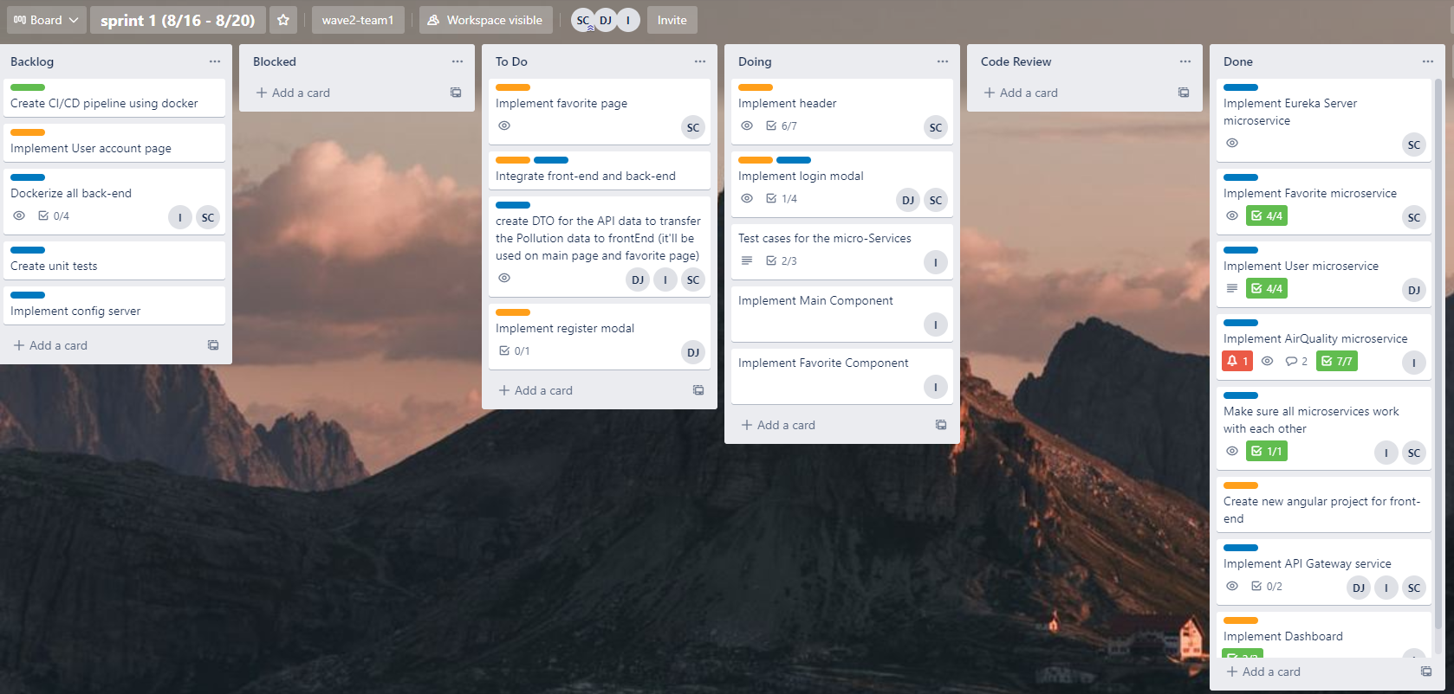
Our Work Process

Slide 56

Our Work Process
Individual & group goal for the day
What was complete & To do for the next day
On call whole day to assist each other
8:30 am
4:50 pm

Slide 57
Challenges
Front to back-end integration was very new
Code not working sometimes on certain laptops
Remote collaboration

Slide 58
Our Takeaway

Slide 59

Thank you for listening!

Slide 60

Any Questions?

Slide 61
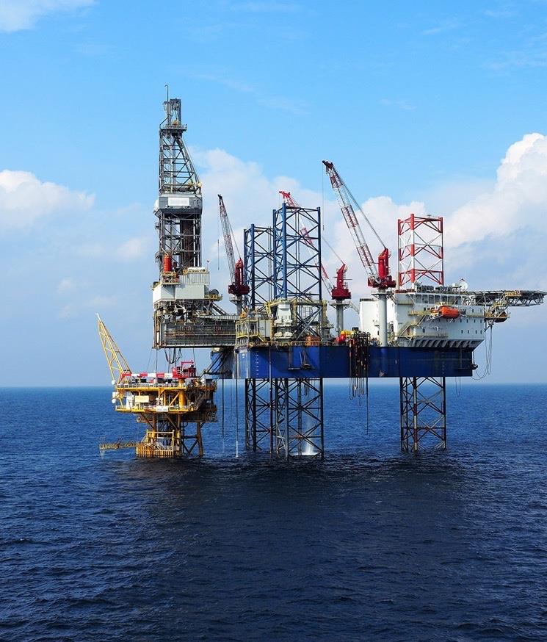
Note regarding images – REMOVE THIS NOTE PRIOR TO DISTRIBUTION
To update this image, delete the current image and click on the Image icon to change to a new picture located on your computer. Additional images are available in the image library of Brand Source at https://brand.cgi.com/.

Slide 62
Agenda
01
02
03
04
05

Slide 63
Agenda – layout 1
Agenda item 1
Agenda item 2
Agenda item 3
Agenda item 4
Agenda item 5
Agenda item 6
Agenda item 7
Agenda item 8
Agenda item 9
Agenda item 10
Agenda item 11
Agenda item 12
● | Agenda item 1 | ● | Agenda item 7
● | Agenda item 2 | ● | Agenda item 8
● | Agenda item 3 | ● | Agenda item 9
● | Agenda item 4 | ● | Agenda item 10
● | Agenda item 5 | ● | Agenda item 11
● | Agenda item 6 | ● | Agenda item 12

Slide 65
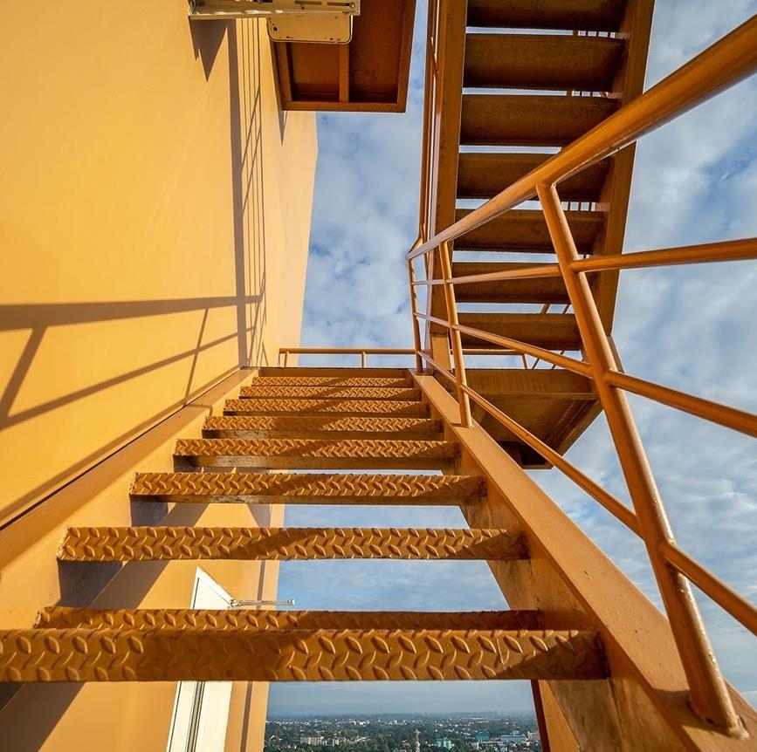
Note regarding images – REMOVE THIS NOTE PRIOR TO DISTRIBUTION
To update this image, delete the current image and click on the Image icon to change to a new picture located on your computer. Additional images are available in the image library of Brand Source at https://brand.cgi.com/.

Slide 66

Note regarding images – REMOVE THIS NOTE PRIOR TO DISTRIBUTION
To update this image, delete the current image and click on the Image icon to change to a new picture located on your computer. Additional images are available in the image library of Brand Source at https://brand.cgi.com/.

Slide 67

Note regarding images – REMOVE THIS NOTE PRIOR TO DISTRIBUTION
To update this image, delete the current image and click on the Image icon to change to a new picture located on your computer. Additional images are available in the image library of Brand Source at https://brand.cgi.com/.

Slide 68

Note regarding images – REMOVE THIS NOTE PRIOR TO DISTRIBUTION
To update this image, delete the current image and click on the Image icon to change to a new picture located on your computer. Additional images are available in the image library of Brand Source at https://brand.cgi.com/.

Slide 72


Slide 73
Profile
CGI experience

Slide 74
Focus areas
Other experience
Insert here
Insert here
Insert here
Languages
Insert here
Insert here
Insert here
Company, Project (Dates mm/yy to mm/yy)
Provide a brief project description or your tasks in a short paragraph
Provide a brief project description or your tasks in a short paragraph
Provide a brief project description or your tasks in a short paragraph
Provide a brief project description or your tasks in a short paragraph
Company, Project (Dates mm/yy to mm/yy)
Provide a brief project description or your tasks in a short paragraph
Provide a brief project description or your tasks in a short paragraph
Provide a brief project description or your tasks in a short paragraph
Provide a brief project description or your tasks in a short paragraph
Company, Project (Dates mm/yy to mm/yy)
Provide a brief project description or your tasks in a short paragraph
Provide a brief project description or your tasks in a short paragraph
Provide a brief project description or your tasks in a short paragraph
Provide a brief project description or your tasks in a short paragraph

Slide 78


Slide 79


Slide 80



Slide 81


Slide 82
Donut

Slide 83
Column clustered

Slide 84
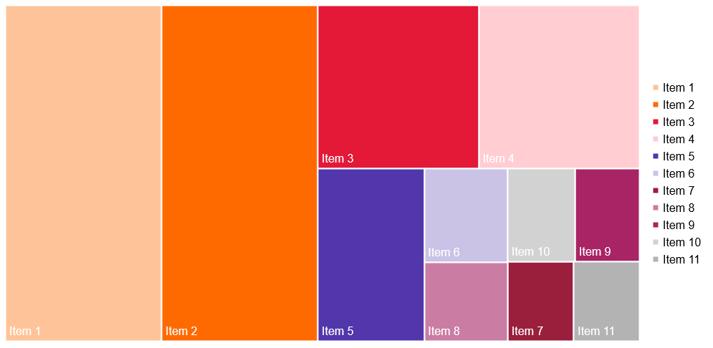
Tree map

Slide 85
XY scattered

Slide 86
Columns stacked

Slide 87
Small multiples – color by category

Slide 88
Financial results
Title
Text | Number
Text | Number
Text | Number
Text | Number

Slide 89
Heat map
 | Text | Text | Text | Text | Text
Text
Text
Text
Text

Slide 90
Insights you can act on

